Slide 1
EE653 Power distribution system modeling, optimization and simulation
ECpE Department
Dr. Zhaoyu Wang
1113 Coover Hall, Ames, IA
wzy@iastate.edu

Slide 2
Approximate Method of Analysis
Acknowledgement: The slides are developed based in part on Distribution System Modeling and Analysis, 4th edition, William H. Kersting, CRC Press, 2017
ECpE Department

Slide 3
Approximate Method of Analysis
A distribution feeder provides service to unbalanced three-phase, two-phase, and single-phase loads over untransposed three-phase, two-phase, and single-phase line segments. This combination leads to the three-phase line currents and the line voltages being unbalanced. In order to analyze these conditions as precisely as possible, it will be necessary to model all three phases of the feeder as accurately as possible. However, many times only a “ballpark” answer is needed. When this is the case, some approximate methods of modeling and analysis can be employed. It is the purpose of this chapter to develop some of the approximate methods and leave for later classes the exact models and analysis.
ECpE Department

Slide 4
Approximate Method of Analysis
All of the approximate methods of modeling and analysis will assume perfectly balanced three-phase systems. It will be assumed that all loads are balanced three phase and all line segments will be three phase and perfectly transposed. With these assumptions a single line-to-neutral equivalent circuit for the feeder will be used.
ECpE Department

Slide 5
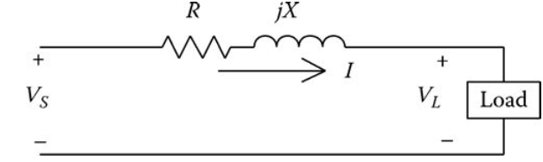
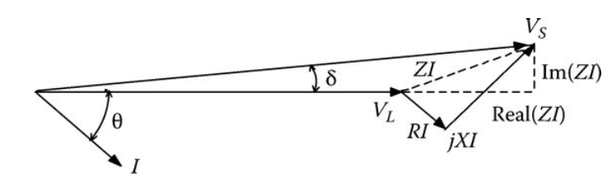
Voltage Drop
A line-to-neutral equivalent circuit of a three-phase line segment serving a balanced three-phase load is shown in Fig.1.
Kirchhoff's voltage law applied to the circuit of Fig.1 gives
$$V_{S}=V_{L}+\left(R+jX\right)∗I=V_{L}+R∗I+jX∗I$$
(1)
The phasor diagram for above equation (1) is shown in Fig.2.
Fig.1 Customer demand curve
Fig.2 Customer demand curve
ECpE Department

Slide 6

Voltage Drop
In Fig.2 the phasor for the voltage drop through the line resistance (RI) is shown in phase with the current phasor, and the phasor for the voltage drop through the reactance (jXI) is shown leading the current phasor by 90°. The dashed lines in Fig.2 represent the real and imaginary parts of the impedance (ZI) drop. The voltage drop down the line is defined as the difference between the magnitudes of the source and the load voltages:
$$V_{drop}=\left|V_{S}\right|−\left|V_{L}\right|$$
(2)
Fig.1 Customer demand curve
Fig.2 Customer demand curve
ECpE Department

Slide 7

Voltage Drop
The angle between the source voltage and the load voltage (δ) is very small. Because of that, the voltage drop between the source and load is approximately equal to the real part of the impedance drop. The definition of voltage drop:
$$V_{drop}≅Re(Z∗I)$$
(3)
Fig.1 Customer demand curve
Fig.2 Customer demand curve
ECpE Department

Slide 8
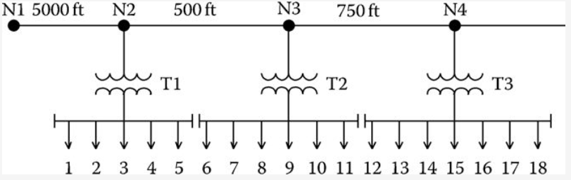



Example 1
In follow Fig.3 and Example 2.3, the impedance of the first line segment is
$$Z_{12}=0.2841+j0.5682 Ω$$
The current flowing through the line segment is
$I_{12}=43.0093∠−25.8419$ A
The voltage at node N1 is
$V_{1}=2400∠0.0$ V
The exact voltage at node N2 is computed to be
$$V_{2}=2400∠0.0−\left(0.2841+j0.5682\right)∗43.0093∠−25.8419$$
$=2378.4098∠−0.4015$ V
Fig.3
ECpE Department

Slide 9

Example 1
The voltage drop between the nodes is then
$$V_{drop}=2400.0000−2378.4098=21.5902 V$$
Compute the voltage drop according to equation (3) gives
$$V_{drop}=Re\left[\left(0.2841+j0.5682\right)∗43.0093∠−25.8419\right]=21.6486 V$$
$Error=\frac{21.5902−21.6486}{21.5902}∗100$=-0.27%
This example demonstrates the very small error in computing voltage drop when using the approximate equation given by equation (3).
Fig.3
ECpE Department

Slide 10
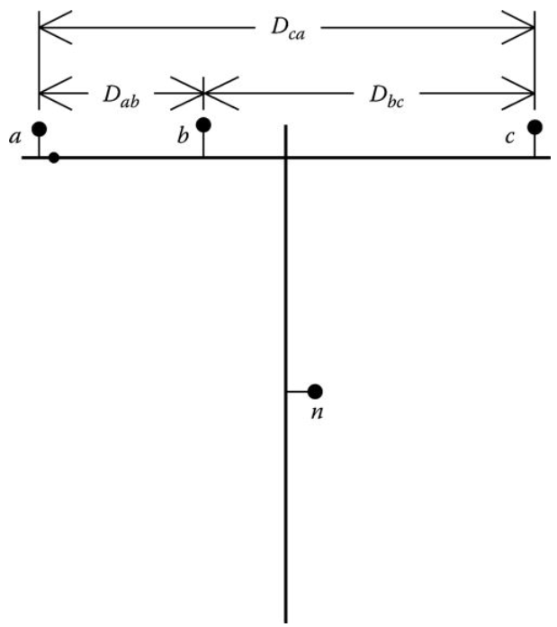
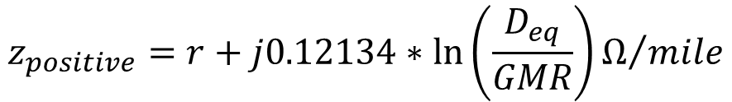

Line Impedance
For the approximate modeling of a line segment, it will be assumed that the line segment is transposed. With this assumption only the positive sequence impedance of the line segment needs to be determined. A typical three-phase line configuration is shown in Fig.4.
The equation for the positive sequence impedance for the configuration shown in Fig.4.
$$z_{positive}=r+j0.12134∗\ln\left(\frac{D_{eq}}{GMR}\right)Ω/{mile}$$
(4)
$$D_{eq}=\sqrt[3]{D_{ab}∗D_{bc}∗D_{ca}} (ft)$$
(5.a)
Fig.4 Three-phase line configuration
GMR is the conductor geometric mean radius (from tables) in feet.
ECpE Department

Slide 11
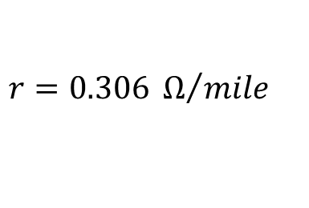



Example 2
A three-phase line segment has the configuration shown in Fig.4. The spacings between conductors
$D_{ab}=2.5 ft$, $D_{bc}=4.5 ft$, $D_{ca}=7.0 ft$,
The conductors of the line are 336,400 26/7 Aluminum Conductor Steel Reinforced (ACSR).
Determine the positive sequence impedance of the line in Ω/mile.
Solution:
From the table of conductor data in Appendix A,
$$r=0.306 Ω/{mile}$$
$$GMR=0.0244 ft$$
Compute the equivalent spacing
$$D_{eq}=\sqrt[3]{2.5∗4.5∗7.0}=4.2863 (ft)$$
Using Equation (4),
$$z_{positive}=0.306+j0.12134∗\ln\left(\frac{4.2863}{0.0244}\right)=0.306+j0.6272 Ω/{mile}$$
ECpE Department

Slide 12
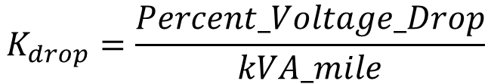
K Factors
A first approximation for calculating the voltage drop along a line segment is given by Equation (3). Another approximation is made by employing a “K” factor. There will be two types of K factors, one for voltage drop and the other for voltage rise calculations.
The K_{drop} factor is defined as:
$$K_{drop}=\frac{Percent_Voltage_Drop}{kVA_mile}$$
(5.b)
The K_{drop} factor is determined by computing the percent voltage drop down a line that is 1 mile long and serving a balanced three-phase load of 1 kVA. The percent voltage drop is referenced to the nominal line-to-neutral voltage of the line. In order to calculate this factor, the power factor of the load must be assumed.
ECpE Department

Slide 13

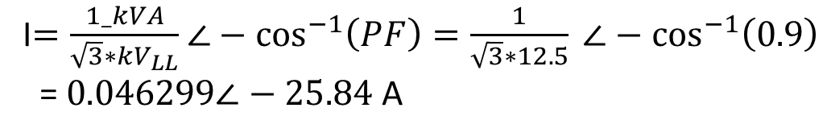
Example 3
For the line of Example 3.2, compute the K_{drop} factor assuming a load power factor of 0.9 lagging and a nominal voltage of 12.47 kV (line to line).
Solution:
The impedance of 1 mile of line was computed to be
$Z=0.306+j0.6272 Ω$
The current taken by 1 kVA at 0.9 lagging power factor is given by
I$=\frac{1_kVA}{\sqrt{3}∗kV_{LL}}$ $∠−\cos^{−1}\left(PF\right)=\frac{1}{\sqrt{3}∗12.5} ∠−\cos^{−1}\left(0.9\right)$
= $0.046299∠−25.84$ A
ECpE Department

Slide 14
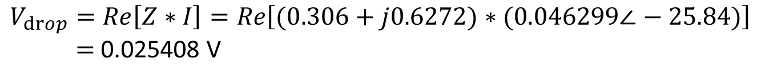
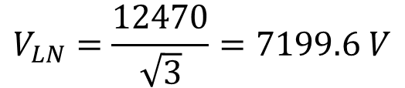
Example 3
The voltage drop is computed to be
$$V_{drop}=Re\left[Z∗I\right]=Re\left[(0.306+j0.6272)∗(0.046299∠−25.84)\right]$$
$=$0.025408 V
The nominal line-to-neutral voltage is
$$V_{LN}=\frac{12470}{\sqrt{3}}=7199.6 V$$
The K_{drop} factor is then
$K_{drop}=\frac{0.025408}{7199.6}∗100=0.00035291\%drop/kVA_$mile
ECpE Department

Slide 15
Example 3
The K_{drop} factor computed in Example 3.3 is for the 336,400 26/7 ACSR conductor with the conductor spacings defined in Example 3.2, a nominal voltage of 12.47 kV, and a load power factor of 0.9 lagging. Unique K_{drop} factors can be determined for all standard conductors, spacings, and voltages. Fortunately, most utilities will have a set of standard conductors, standard conductor spacings, and one or two standard distribution voltages. Because of this, a simple spreadsheet program can be written that will compute the K_{drop} factors for the standard configurations. The assumed power factor of 0.9 lagging is a good approximation of the power factor for a feeder serving a predominately residential load.
The K_{drop} factor can be used to quickly compute the approximate voltage drop down a line section. For example, assume a load of 7500 kVA is to be served at a point 1.5 miles from the substation. Using the K_{drop} factor computed in Example 3.3, the percent voltage drop down the line segment is computed to be
$$V_{drop}=K_{drop}∗kVA_{mile}=0.00035291∗7500∗1.5=3.9702\%$$
ECpE Department

Slide 16
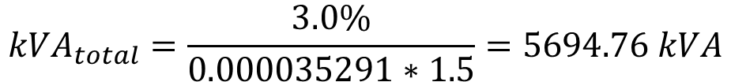
Example 3
This example demonstrates that a load of 7500 kVA can be served 1.5 miles from the substation with a resulting voltage drop of 3.97%. Suppose now that the utility has a maximum allowable voltage drop of 3.0%. Then the load that can be served 1.5 miles from the substation is given by
$${kVA}_{total}=\frac{3.0\%}{0.000035291∗1.5}=5694.76 kVA$$
The application of the K_{drop} factor is not limited to computing the percent voltage drop down just one line segment. When line segments are in cascade, the total percent voltage drop from the source to the end of the last line segment is the sum of the percent drops in each line segment. This seems logical but it must be understood that in all cases the percent drop is in reference to the nominal line-to-neutral voltage. That is, the percent voltage drop in a line segment is not referenced to the source end voltage but rather to the nominal line-to-neutral voltage, as would be the usual case. Example 3.4 demonstrates this application.
ECpE Department

Slide 17
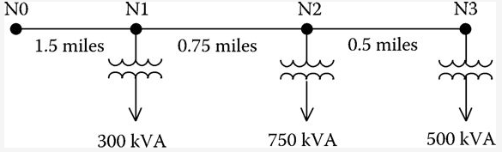

Example 4
A three-segment feeder is shown in Fig.5.
The K_{drop} factor for the line segments is
$K_{drop}=0.00003591$
Determine the percent voltage drop from N0 to N3.
Solution:
The total kVA flowing in segment N0 to N1 is
${kVA}_{01}=300+750+500=1550 kVA$
Fig.5 Three segment feeder
ECpE Department

Slide 18
Example 4
The percent voltage drop from N0 to N1 is
$V_{drop01}=0.00003591∗1550∗1.5=0.8205\%$
The total kVA flowing in segment N1 to N2 is
${kVA}_{12}=750+500=1250 kVA$
The percent voltage drop from N1 to N2 is
$V_{drop12}=0.00003591∗1250∗0.75=0.3308\%$
Fig.5 Three segment feeder
ECpE Department

Slide 19

Example 4
The kVA flowing in segment N2 to N3 is
${kVA}_{23}=500 kVA$
The percent voltage drop in the last line segment is
$V_{drop23}=0.00003591∗500∗0.5=0.0882\%$
The total percent voltage drop from N0 to N3 is
$V_{drop_total}=0.8205+0.3308+0.0882=1.2396\%$
The application of the K_{drop} factor provides an easy way of computing the approximate percent voltage drop from a source to a load. It should be kept in mind that the assumption has been a perfectly balanced three-phase load, an assumed load power factor, and transposed line segments. Even with these assumptions, the results will always provide a “ballpark” result that can be used to verify the results of more sophisticated methods of computing voltage drop.
ECpE Department

Slide 20
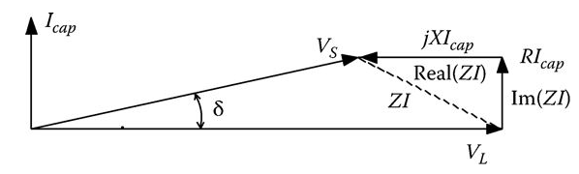

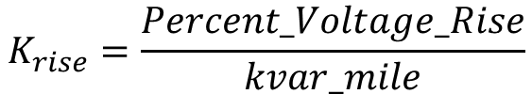
K Factors
The K_{rise} factor is similar to the K_{drop} factor except now the “load” is a shunt capacitor. When a leading current flows through an inductive reactance, there will be a voltage rise, rather than a voltage drop, across the reactance. This is illustrated by the phasor diagram in Fig.6.
Referring to Fig.6 the voltage rise is defined as:
$$V_{rise}=\left|Re(ZI_{cap})\right|=X∗\left|I_{cap}\right|$$
(6)
In equation (6) it is necessary to take the magnitude of the real part of ZI so that the voltage rise is a positive number. The K_{rise} factor is defined exactly the same as for the K_{drop} factor:
$$K_{rise}=\frac{Percent_Voltage_Rise}{kvar_mile}$$
(7)
Fig.6 Voltage rise phasor diagram
ECpE Department

Slide 21

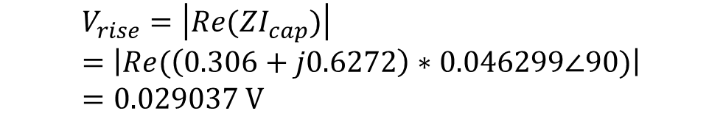
Example 5
Q1. Calculate the K_{rise} factor for the line of Fig.4 from Example 3.2.
Solution:
The impedance of 1 mile of line was computed to be:
$Z=0.306+j0.6272 Ω$
The current taken by a 1 kvar three-phase capacitor bank is given by
I$=\frac{1_kvar}{\sqrt{3}∗kV_{LL}}$ $∠90=\frac{1}{\sqrt{3}∗12.47}∠90$ = $0.046299∠90$ A
The voltage rise per kvar-mile is computed to be
$$V_{rise}=\left|Re(ZI_{cap})\right|=\left|Re(\left(0.306+j0.6272\right)∗0.046299∠90)\right|$$
$=0.029037 V$
Fig.4 Three-phase line configuration
ECpE Department

Slide 22
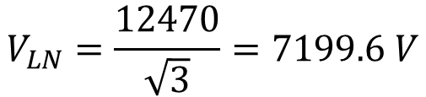
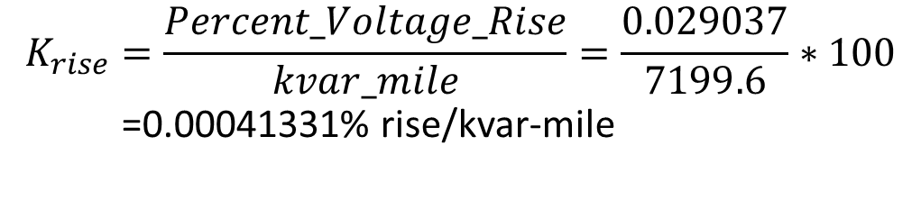
Example 5
Q1. Calculate the K_{rise} factor for the line of Fig.4 from Example 3.2.
Solution:
The nominal line-to-neutral voltage is
$$V_{LN}=\frac{12470}{\sqrt{3}}=7199.6 V$$
The K_{rise} factor is then
$$K_{rise}=\frac{Percent_Voltage_Rise}{kvar_mile}=\frac{0.029037}{7199.6}∗100$$
=0.00041331% rise/kvar-mile
Fig.4 Three-phase line configuration
ECpE Department

Slide 23
Example 5
Q2. Determine the rating of a three-phase capacitor bank to limit the voltage drop in Example 3.3 to 2.5%.
Solution:
The percent voltage drop in Example 3.3 was computed to be 3.9702%. To limit the total voltage drop to 2.5%, the required voltage rise due to a shunt capacitor bank is
$$V_{rise}=3.9702−2.5=1.4702 \%$$
The required rating of the shunt capacitor is
$$kvar=\frac{V_{rise}}{K_{rise}∗mile}=\frac{1.4702}{0.00040331∗1.5}=2430.18 kvar$$
ECpE Department

Slide 24
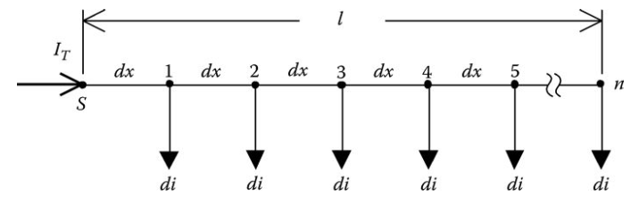
Uniformly Distributed Loads
Many times it can be assumed that loads are uniformly distributed along a line where the line can be a three-phase, two-phase, or single-phase feeder or lateral. This is certainly the case on single-phase laterals where the same rating transformers are spaced uniformly over the length of the lateral. When the loads are uniformly distributed, it is not necessary to model each load in order to determine the total voltage drop from the source end to the last load. Fig.7 shows a generalized line with n uniformly distributed loads.
Fig.7 Voltage rise phasor diagram
ECpE Department

Slide 25



Uniformly Distributed Loads-Voltage Drop
Fig.7 shows n uniformly spaced loads dx miles apart. The loads are all equal and will be treated as constant current loads with a value of di. The total current into the feeder is I_{T}. It is desired to determine the total voltage drop from the source node (S) to the last node n.
Let
l be the length of the feeder
z = r + jx be the impedance of the line in Ω/mile
dx be the length of each line section
di be the load currents at each node
n be the number of nodes and number of line sections
I_{T} be the total current into the feeder
The load currents are given by
$$di=\frac{I_{T}}{n}$$
(8)
The voltage drop in the first line segment is given by
$$V_{drop1}=Re\{z∗dx∗(n∗di)\}$$
(9)
The voltage drop in the second line segment is given by
$$V_{drop2}=Re\{z∗dx∗[(n−1)∗di]\}$$
(10)
Fig.7 Voltage rise phasor diagram
ECpE Department

Slide 26

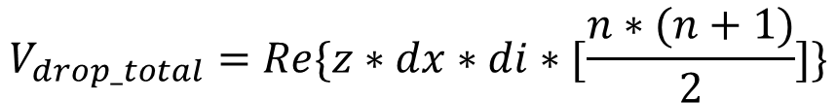
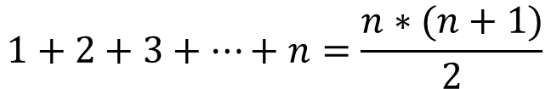
Uniformly Distributed Loads-Voltage Drop
The total voltage drop from the source node to the last node is then given by
$V_{drop_total}=V_{drop_1}+V_{drop_2}$+…+$V_{drop_n}$
$$V_{drop_total}=Re\{z∗dx∗di∗[n+\left(n−1\right)+(n−2+…+(1))]\}$$
(11)
Equation (11) can be reduced by recognizing the series expansion:
$$1+2+3+…+n=\frac{n∗(n+1)}{2}$$
(12)
$$n+\left(n−1\right)+\left(n−2\right)+…+1=\frac{n∗(n+1)}{2}$$
Using the expansion, Equation (11) becomes
$$V_{drop_total}=Re\{z∗dx∗di∗[\frac{n∗(n+1)}{2}]\}$$
(13)
Fig.7 Voltage rise phasor diagram
ECpE Department

Slide 27
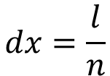
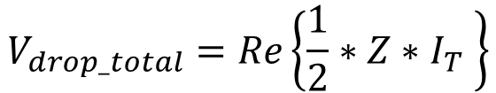
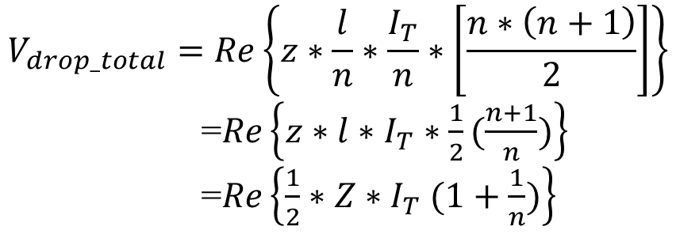
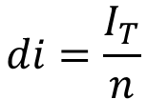
Uniformly Distributed Loads-Voltage Drop
The incremental distance and incremental distance is
$$dx=\frac{l}{n}$$
$$di=\frac{I_{T}}{n}$$
(14)
(15)
Substituting Equations (14) and (15) into Equation (13) results in
$$V_{drop_total}=Re\left\{z∗\frac{l}{n}∗\frac{I_{T}}{n}∗\left[\frac{n∗\left(n+1\right)}{2}\right]\right\}$$
=$Re\left\{z∗l∗I_{T}∗\frac{1}{2}(\frac{n+1}{n})\right\}$
=$Re\left\{\frac{1}{2}∗Z∗I_{T} (1+\frac{1}{n})\right\}$
(16)
where Z = z · l.
Equation (16) gives the general equation for computing the total voltage drop from the source to the last node n for a line of length l. In the limiting case where n goes to infinity, the final equation becomes
$$V_{drop_total}=Re\left\{\frac{1}{2}∗Z∗I_{T} \right\}$$
(17)
ECpE Department

Slide 28
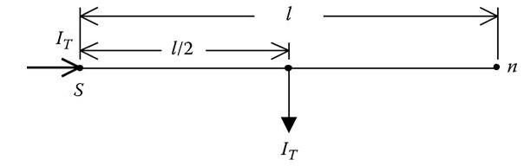
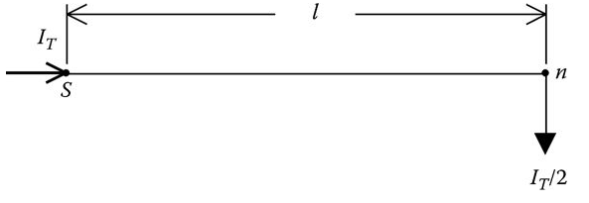

Uniformly Distributed Loads-Voltage Drop
In Equation (17) Z represents the total impedance from the source to the end of the line. The voltage drop is the total from the source to the end of the line. The equation can be interpreted in two ways. The first is to recognize that the total line distributed load can be lumped at the midpoint of the lateral as shown in Fig.8.
A second interpretation of Equation (17) is to lump one-half of the total line load at the end of the line (node n). This model is shown in Fig.9.
Fig.8 and Fig.9 give two different models that can be used to calculate the total voltage drop from the source to the end of a line with uniformly distributed loads.
$$V_{drop_total}=Re\left\{\frac{1}{2}∗Z∗I_{T} \right\}$$
(17)
Fig.8 Load lumped at the midpoint
Fig.9 One-half load lumped at the end
ECpE Department

Slide 29
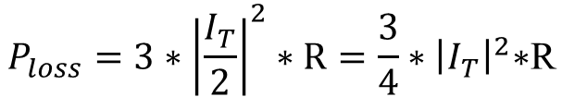

Uniformly Distributed Loads-Power Loss
Of equal importance in the analysis of a distribution feeder is the power loss. If the model of Fig.8 is used to compute the total three-phase power loss down the line, the result is
$$P_{loss}=3∗{\left|I_{T}\right|}^{2}∗\frac{R}{2}=\frac{3}{2}∗{\left|I_{T}\right|}^{2}\text{∗}\text{R}$$
(18)
When the model of Fig.9 is used to compute the total three-phase power loss, the result is
$$P_{loss}=3∗{\left|\frac{I_{T}}{2}\right|}^{2}∗R=\frac{3}{4}∗{\left|I_{T}\right|}^{2}\text{∗}\text{R}$$
(19)
It is obvious that the two models give different results for the power loss. The question is, Which one is correct?
Fig.8 Load lumped at the midpoint
Fig.9 One-half load lumped at the end
ECpE Department

Slide 30


Uniformly Distributed Loads-Power Loss
The answer is neither one…
To derive the correct model for power loss, reference is made to Fig.7 and the definitions for the parameters in that figure. The total three-phase power loss down the line will be the sum of the power losses in each short segment of the line. For example, the three-phase power loss in the first segment is
$$P_{loss1}=3∗(r∗dx)∗{\left|(n∗di)\right|}^{2}$$
(20)
The power loss in the second segment is given by
$$P_{loss2}=3∗(r∗dx)∗{\left|\left(n−1\right)∗di\right|}^{2}$$
(21)
Fig.7 Voltage rise phasor diagram
ECpE Department

Slide 31
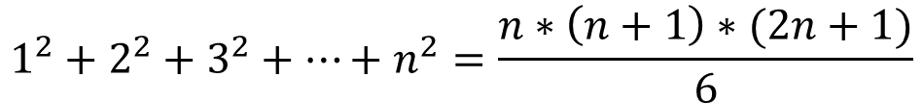
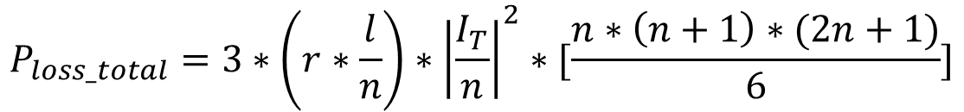
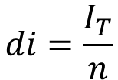
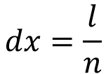
Uniformly Distributed Loads-Power Loss
The total power loss over the length of the line is then given by
$$P_{loss_total}=3∗\left(r∗dx\right)∗{\left|di\right|}^{2}∗[n^{2}+{\left(n−1\right)}^{2}+{\left(n−2\right)}^{2}+…+1^{2}]$$
(22)
The series inside the bracket of Equation (22) is the sum of the squares of n numbers and is equal to
$$1^{2}+2^{2}+3^{2}+…+n^{2}=\frac{n∗\left(n+1\right)∗(2n+1)}{6}$$
(23)
Substituting Equations (14), (15), and (23) into Equation (22) gives
$$dx=\frac{l}{n}$$
$$di=\frac{I_{T}}{n}$$
(14)
(15)
$$P_{loss_total}=3∗\left(r∗\frac{l}{n}\right)∗{\left|\frac{I_{T}}{n}\right|}^{2}∗[\frac{n∗\left(n+1\right)∗(2n+1)}{6}]$$
(24)
ECpE Department

Slide 32
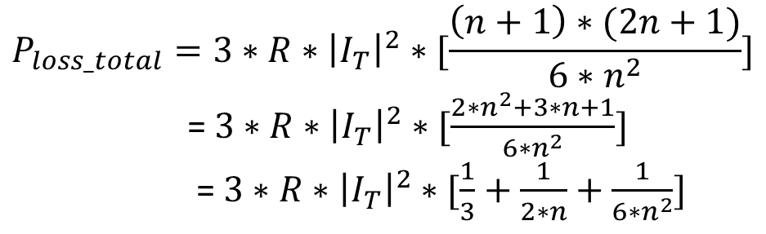
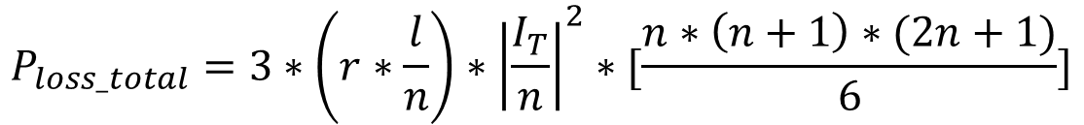
Uniformly Distributed Loads-Power Loss
$$P_{loss_total}=3∗\left(r∗\frac{l}{n}\right)∗{\left|\frac{I_{T}}{n}\right|}^{2}∗[\frac{n∗\left(n+1\right)∗(2n+1)}{6}]$$
(24)
Simplifying Equation (24)
$$P_{loss_total}=3∗R∗{\left|I_{T}\right|}^{2}∗[\frac{\left(n+1\right)∗(2n+1)}{6∗n^{2}}]$$
= $3∗R∗{\left|I_{T}\right|}^{2}∗[\frac{2∗n^{2}+3∗n+1}{6∗n^{2}}]$
= $3∗R∗{\left|I_{T}\right|}^{2}∗[\frac{1}{3}+\frac{1}{2∗n}+\frac{1}{6∗n^{2}}]$
(25)
where R = r · l is the total resistance per phase of the line segment.
ECpE Department

Slide 33
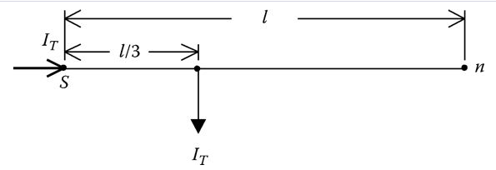


Uniformly Distributed Loads-Power Loss
$$P_{loss_total}=3∗R∗{\left|I_{T}\right|}^{2}∗[\frac{1}{3}+\frac{1}{2∗n}+\frac{1}{6∗n^{2}}]$$
(25)
Equation (25) gives the total three-phase power loss for a discrete number of nodes and line segments. For a truly uniformly distributed load, the number of nodes goes to infinity. When that limiting case is taken in Equation (25), the final equation for computing the total three-phase power loss down the line is given by
$$P_{loss_total}=3 [\frac{1}{3}∗R∗{\left|I_{T}\right|}^{2}]$$
(26)
where R = r · l is the total resistance per phase of the line segment.
A circuit model for Equation (26) is given in Figure 3.9.
Fig.10 Power loss model
ECpE Department

Slide 34
Uniformly Distributed Loads-Power Loss
From a comparison of Fig.8 and Fig.9, used for voltage drop calculations, to Fig.10, used for power loss calculations, it is obvious that the same model cannot be used for both voltage drop and power loss calculations.
Fig.8 Load lumped at the midpoint
Fig.9 One-half load lumped at the end
Fig.10 Power loss model
ECpE Department

Slide 35
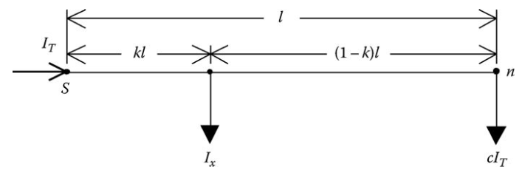
Uniformly Distributed Loads-Exact
Lumped Load Model
In the previous sections lumped load models were developed. The first models of Voltage Drop section can be used for the computation of the total voltage drop down the line. It was shown that the same models cannot be used for the computation of the total power loss down the line. Power Loss section developed a model that will give the correct power loss of the line. What is needed is one model that will work for both voltage drop and power loss calculations.
Fig.11 shows the general configuration of the “exact” model that will give correct results for voltage drop and power loss.
Fig.11 General exact lumped load model
ECpE Department

Slide 36
Uniformly Distributed Loads-Exact
Lumped Load Model
In Fig.11 a portion (I_{x}) of the total line current (I_{T}) will be modeled kl miles from the source end and the remaining current (cI_{T}) will be modeled at the end of the line. The values of k and c need to be derived.
In Fig.11 the total voltage drop down the line is given by
$$V_{drop_total}=Re [k∗Z∗I_{T}+\left(1−k\right)∗Z∗c∗I_{T}]$$
(27)
where
Z is the total line impedance in ohms
k is the factor of the total line length where the first part of the load current is modeled
c is the factor of the total current to be placed at the end of the line such that I_{T} = I_{x} + c · I_{T}
Fig.11 General exact lumped load model
ECpE Department

Slide 37

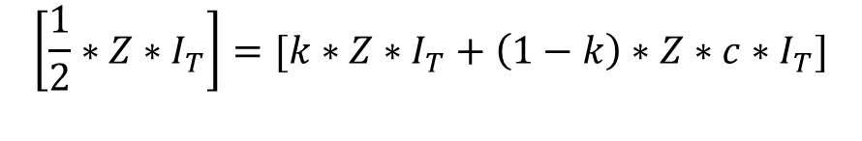
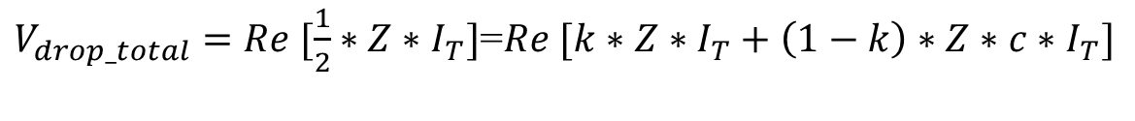

Uniformly Distributed Loads-Exact
Lumped Load Model
In Voltage Drop section, it was shown that the total voltage drop down the line is given by
$$V_{drop_total}=Re [\frac{1}{2}∗Z∗I_{T}]$$
(28)
Set Equation (17) equal to Equation (27):
$$V_{drop_total}=Re\left\{\frac{1}{2}∗Z∗I_{T} \right\}$$
(17)
$$V_{drop_total}=Re [k∗Z∗I_{T}+\left(1−k\right)∗Z∗c∗I_{T}]$$
(27)
$V_{drop_total}=Re [\frac{1}{2}∗Z∗I_{T}]$=$Re [k∗Z∗I_{T}+\left(1−k\right)∗Z∗c∗I_{T}]$
(29)
Equation (29) shows that the terms inside the brackets on both sides of the equal side need to be set equal, that is
$$\left[\frac{1}{2}∗Z∗I_{T}\right]=[k∗Z∗I_{T}+\left(1−k\right)∗Z∗c∗I_{T}]$$
(30)
ECpE Department

Slide 38
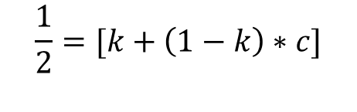
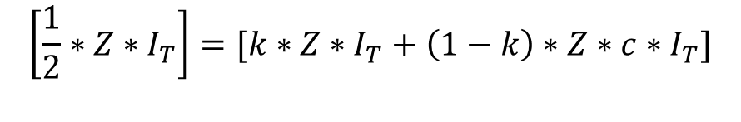
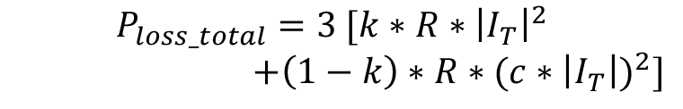

Uniformly Distributed Loads-Exact
Lumped Load Model
$$\left[\frac{1}{2}∗Z∗I_{T}\right]=[k∗Z∗I_{T}+\left(1−k\right)∗Z∗c∗I_{T}]$$
(30)
Simplify Equation (30) by dividing both sides of the equation by ZI_{T}:
$$\frac{1}{2}=[k+\left(1−k\right)∗c]$$
(31)
Solve Equation (31) for k:
$$k=\frac{0.5−c}{1−c}$$
(32)
The same procedure can be followed for the power loss model. The total three-phase power loss in Fig.11 is given by
$$P_{loss_total}=3 [k∗R∗{\left|I_{T}\right|}^{2}$$
$+\left(1−k\right)∗R∗{(c∗\left|I_{T}\right|)}^{2}]$
(33)
Fig.11 General exact lumped load model
ECpE Department

Slide 39

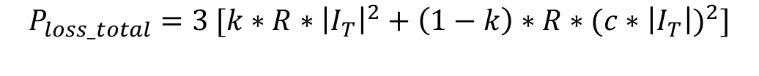
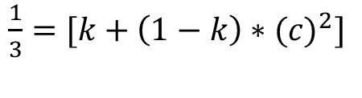
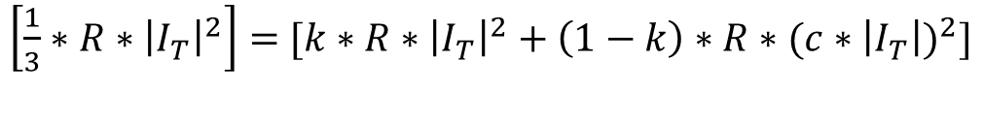
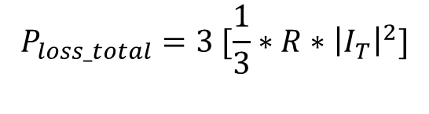
Uniformly Distributed Loads-Exact
Lumped Load Model
$$P_{loss_total}=3 [k∗R∗{\left|I_{T}\right|}^{2}+\left(1−k\right)∗R∗{(c∗\left|I_{T}\right|)}^{2}]$$
(33)
  The model for the power loss of Fig.10 gives the total three-phase power loss as
$$P_{loss_total}=3 [\frac{1}{3}∗R∗{\left|I_{T}\right|}^{2}]$$
(34)
Equate the terms inside the brackets of Equations (33) and (34) and simplify:
$\left[\frac{1}{3}∗R∗{\left|I_{T}\right|}^{2}\right]=$ $[k∗R∗{\left|I_{T}\right|}^{2}+\left(1−k\right)∗R∗{(c∗\left|I_{T}\right|)}^{2}]$
$\frac{1}{3}=$ $[k+\left(1−k\right)∗{(c)}^{2}]$
$\frac{1}{3}=$ $\left[k+c^{2}−k∗c^{2}\right]= \left[k∗{(1−c}^{2})+c^{2}\right]$
(35)
Fig.10 Power loss model
ECpE Department

Slide 40

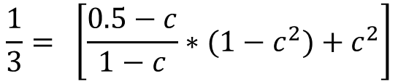



Uniformly Distributed Loads-Exact
Lumped Load Model
$$k=\frac{0.5−c}{1−c}$$
(32)
$\frac{1}{3}=$ $\left[k+c^{2}−k∗c^{2}\right]= \left[k∗{(1−c}^{2})+c^{2}\right]$
(35)
Substitute Equation (32) into Equation (35)
$$\frac{1}{3}= \left[\frac{0.5−c}{1−c}∗{(1−c}^{2})+c^{2}\right]$$
(36)
Solving Equation (36) for c results in
$$c=\frac{1}{3}$$
(37)
Substitute Equation (37) into Equation (32) and solve for k:
$$k=\frac{1}{4}$$
(38)
ECpE Department

Slide 41
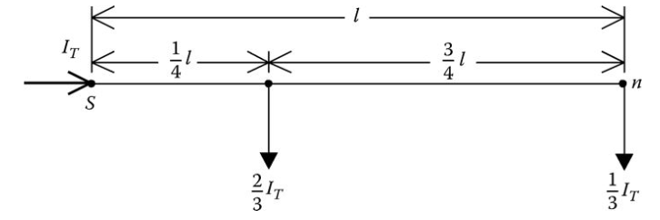
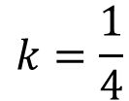
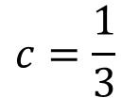
Uniformly Distributed Loads-Exact
Lumped Load Model
$$c=\frac{1}{3}$$
(37)
$$k=\frac{1}{4}$$
(38)
The interpretation of Equations (37) and (38) is that one-third of the load should be placed at the end of the line and two-thirds of the load placed one-fourth of the way from the source end. Figure 3.11 gives the final exact lumped load model.
Fig.12 Exact lumped load model
ECpE Department

Slide 42
Lumping Loads in Geometric Configurations
Many times feeder areas can be represented by geometric configurations such as rectangles, triangles, and trapezoids. By assuming a constant load density in the configurations, approximate calculations can be made for computing the voltage drop and total power losses. The approximate calculations can aid in the determination of the maximum load that can be served in a specified area at a given voltage level and conductor size. For all of the geographical areas to be evaluated, the following definitions will apply:
D represents the load density in kVA/mile².
PF represents the assumed lagging power factor.
z represents the line impedance in Ω/mile.
l represents the length of the area.
w represents the width of the area.
kV_{LL} represents the nominal line-to-line voltage in kV.
It will also be assumed that the loads are modeled as constant current loads.
ECpE Department

Slide 43
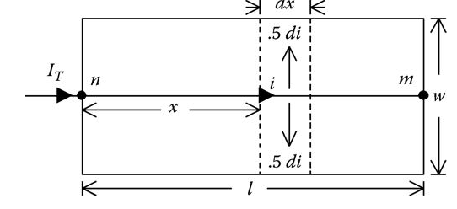
Lumping Loads in Geometric
Configurations-Rectangle
A rectangular area of length l and width w is to be served by a primary main feeder. The feeder area is assumed to have a constant load density with three-phase laterals uniformly tapped off of the primary main. Fig.13 shows a model for the rectangular area.
Fig.13 represents a rectangular area of constant load density being served by a three-phase main running from node n to node m. It is desired to determine the total voltage drop and the total three-phase power loss down the primary main from node n to node m.
dx
Fig.13 Constant load density rectangular area
ECpE Department

Slide 44
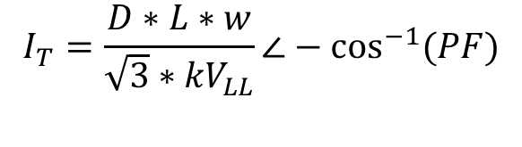

Lumping Loads in Geometric
Configurations-Rectangle
The total current entering the area is given by
$$I_{T}=\frac{D∗L∗w}{\sqrt{3}∗{kV}_{LL}}∠−\cos^{−1}{(PF)}$$
(39)
An incremental segment is located x miles from node n. The incremental current serving the load in the incremental segment is given by
$$di=\frac{I_{T}}{l} A/mile$$
(40)
dx
Fig.13 Constant load density rectangular area
ECpE Department

Slide 45

Lumping Loads in Geometric
Configurations-Rectangle
The current in the incremental segment is given by
$i=I_{T}−x∗di=I_{T}−x∗\frac{I_{T}}{l}=I_{T}$*(1 $− \frac{x}{l}$)
(41)
The voltage drop in the incremental segment is
$$dV=Re(z∗i∗dx)=Re(z∗I_{T}∗\text{(1 }− \frac{x}{l}\text{)}∗dx)$$
(42)
dx
Fig.13 Constant load density rectangular area
ECpE Department

Slide 46


Lumping Loads in Geometric
Configurations-Rectangle
The total voltage drop down the primary main feeder is
$$V_{drop}=\int_{0}^{l}{dv}=Re[z∗I_{T}∗\int_{0}^{l}{\text{(1 }− \frac{x}{l}\text{)}∗dx}]$$
(41)
Evaluating the integral and simplifying,
$V_{drop}=Re[z∗I_{T}∗\frac{1}{2}∗l]$ $=Re[\frac{1}{2}∗Z∗I_{T}]$
(43)
where Z = z · l.
$$V_{drop_total}=Re\left\{\frac{1}{2}∗Z∗I_{T} \right\}$$
(17)
Equation (43) gives the same result as that of Equation (17) which was derived for loads uniformly distributed along a feeder. The only difference here is the manner in which the total current (I_{T}) is determined.
ECpE Department

Slide 47

Lumping Loads in Geometric
Configurations-Rectangle
The bottom line is that the total load of a rectangular area can be modeled at the centroid of the rectangle as shown in Fig.14.
It must be understood that in Fig.14 with the load modeled at the centroid, the voltage drop computed to the load point will represent the total voltage drop from node n to node m.
Fig.14 Rectangle voltage drop model
ECpE Department

Slide 48


Lumping Loads in Geometric
Configurations-Rectangle
A similar derivation can be done in order to determine the total three-phase power loss down the feeder main. The power loss in the incremental length is
$$dp=3∗{\left|i\right|}^{2}∗r∗dx=dp=3∗[{\left|I_{T}\right|}^{2}∗{\left(1−\frac{x}{l}\right)}^{2}∗r∗dx]$$
=3*r*${\left|I_{T}\right|}^{2}$*(1-2*$\frac{x}{l}$+$\frac{x^{2}}{l^{2}}$)*dx
The total three-phase power loss down the primary main is
$P_{loss}=\int_{0}^{l}{dp}=3∗r∗{\left|I_{T}\right|}^{2}∗\int_{0}^{l}{(\text{1−2∗}\frac{x}{l}\text{+}\frac{x^{2}}{l^{2}})}$ $dx$
Fig.15 Rectangle power loss model
ECpE Department

Slide 49


Lumping Loads in Geometric
Configurations-Rectangle
Evaluating the integral and simplifying,
$$P_{loss}=3∗[\frac{1}{3}∗r∗l∗{\left|I_{T}\right|}^{2}]=3∗[\frac{1}{3}∗R∗{\left|I_{T}\right|}^{2}]$$
(44)
where R = r · l.
Equation (44) gives the same result as that of Equation (26). The only difference, again, is the manner in which the total current I_{T} is determined. The model for computing the total three-phase power loss of the primary main feeder is shown in Fig.15. Once again, it must be understood that the power loss computed using the model of Fig.15 represents the total power loss from node n to node m.
$$P_{loss_total}=3 [\frac{1}{3}∗R∗{\left|I_{T}\right|}^{2}]$$
(26)
Fig.15 Rectangle power loss model
ECpE Department

Slide 50
Example 6
It is proposed to serve a rectangular area of length 10,000 ft and width of 6,000 ft. The load density of the area is 2500 kVA/mile² with a power factor of 0.9 lagging. The primary main feeder uses 336,400 26/7 ACSR on a pole configured as shown in Example 3.2, Fig.4. The question at hand is what minimum standard nominal voltage level can be used to serve this area without exceeding a voltage drop of 3% down the primary main? The choices of nominal voltages are 4.16 and 12.47 kV. Compute also the total three-phase power loss.
Fig.4 Three-phase line configuration
ECpE Department

Slide 51




Example 6
Solution
The area to be served is shown in Fig.16.
From Example 3.2, the impedance of the line was computed to be
$$z=0.306+j0.6272 Ω/mile$$
The length and width of the area in miles are
$$l=\frac{10,000}{5,280}=1.8939 miles$$
$$w=\frac{6,000}{5,280}=1.1364 miles$$
Fig.16 Example 3.6: rectangular area
ECpE Department

Slide 52




Example 6
The total area of the rectangular area is
A$=l∗w=2.1522 {mile}^{2}$
The total load of the area is
k$VA=D∗A=2500∗2.1522=5380.6 kVA$
The total impedance of the line segment is
Z$=z∗l=\left(0.306+j0.6272\right)∗1.8939=0.5795+j1.1879Ω$
For a nominal voltage of 4.16 kV, the total area current is
$$I_{T}=\frac{kVA}{\sqrt{3}∗{kV}_{LL}}=\frac{5380.6}{\sqrt{3}∗4.16}∠−\cos^{−1}\left(0.9\right)=746.7∠−25.84 A$$
The total voltage drop down the primary main is
$$V_{drop}=Re\left[\frac{1}{2}∗Z∗I_{T}\right]=Re\left[\frac{1}{2}∗\left(0.5795+j1.1879\right)∗\left(746.7∠−25.84\right)\right]$$
$$=338.1V$$
ECpE Department

Slide 53




Example 6
The nominal line-to-neutral voltage is
$$V_{LN}=\frac{4160}{\sqrt{3}}=2401.8 V$$
The percent voltage drop is
$$V_{\%}=\frac{V_{drop}}{V_{LN}}∗100\%=\frac{388.1}{2401.8}∗100\%=16.16\%$$
It is clear that the nominal voltage of 4.16 kV will not meet the criteria of a voltage drop less than 3.0%.
For a nominal voltage of 12.47 kV, the total area current is
$$I_{T}=\frac{kVA}{\sqrt{3}∗{kV}_{LL}}=\frac{5380.6}{\sqrt{3}∗12.47}∠−\cos^{−1}\left(0.9\right)=249.1∠−25.84 A$$
The total voltage drop down the primary main is
$$V_{drop}=Re\left[\frac{1}{2}∗Z∗I_{T}\right]=Re\left[\frac{1}{2}∗\left(0.5795+j1.1879\right)∗\left(249.1∠−25.84\right)\right]$$
$$=129.5V$$
ECpE Department

Slide 54



Example 6
The nominal line-to-neutral voltage is
$$V_{LN}=\frac{12,470}{\sqrt{3}}=7,199.6 V$$
The percent voltage drop is
$$V_{\%}=\frac{V_{drop}}{V_{LN}}∗100\%=\frac{129.5}{7,199.6}∗100\%=1.80\%$$
The nominal voltage of 12.47 kV is more than adequate to serve this load. It would be possible at this point to determine how much larger the area could be and still satisfy the 3.0% voltage drop constraint.
For the 12.47 kV selection, the total three-phase power loss down the primary main is
$$P_{loss}=3∗\left[\frac{\left(\frac{1}{3}\right)∗R∗{\left|I_{T}\right|}^{2}}{1000}\right]=\left[\frac{\left(\frac{1}{3}\right)∗0.5795∗{\left(249.1\right)}^{2}}{1000}\right]=35.965 kW$$
ECpE Department

Slide 55

Lumping Loads in Geometric
Configurations-Trapezoid
The final geometric configuration to consider is the trapezoid. As before, it is assumed that the load density is constant throughout the trapezoid. The general model of the trapezoid is shown in Fig.17.
Fig.17 shows a trapezoidal area of constant load density being served by a three-phase primary running from node n to node m. It is desired to determine the total voltage drop and the total three-phase power loss down the primary main from node n to node m.
It is necessary to determine the value of the current entering the incremental line segment as a function of the total current and the known dimensions of the trapezoid. The known dimensions will be the length (l) and the widths w₁ and w₂.
Fig.17 General trapezoid
ECpE Department

Slide 56




Lumping Loads in Geometric
Configurations-Trapezoid
The total current entering the trapezoid is
$$I_{T}=\frac{D∗{Area}_{T}}{\sqrt{3}∗{kV}_{LL}}$$
(45)
where Area_{T} is the total area of the trapezoid given by
$${Area}_{T}=\frac{1}{2}∗\left(w_{2}+w_{1}\right)∗l$$
(46)
The current that is delivered to the trapezoid abef is
$$I_{x}=\frac{D∗{Area}_{x}}{\sqrt{3}∗{kV}_{LL}}$$
(47)
where Area_{x} is the area of the trapezoid abef given by
$${Area}_{x}=\frac{1}{2}∗\left(w_{x}+w_{1}\right)∗x$$
(48)
Fig.17 General trapezoid
ECpE Department

Slide 57





Lumping Loads in Geometric
Configurations-Trapezoid
$$I_{T}=\frac{D∗{Area}_{T}}{\sqrt{3}∗{kV}_{LL}}$$
(45)
Solve Equation (45) for D:
$$D=\frac{\sqrt{3}∗{kV}_{LL}∗I_{T}}{{Area}_{T}}$$
(49)
Substitute Equation (49) into Equation (47):
$$I_{x}=\frac{D∗{Area}_{x}}{\sqrt{3}∗{kV}_{LL}}$$
(47)
$I_{x}=$($\frac{\sqrt{3}∗{kV}_{LL}∗I_{T}}{{Area}_{T}}$)*($\frac{{Area}_{x}}{\sqrt{3}∗{kV}_{LL}}$)=$\frac{{Area}_{x}}{{Area}_{T}}∗I_{T}$
(50)
The current entering the incremental line segment is
$$i=I_{T}−I_{x}=(1−\frac{{Area}_{x}}{{Area}_{T}})∗I_{T}$$
(51)
Fig.17 General trapezoid
ECpE Department

Slide 58




Lumping Loads in Geometric
Configurations-Trapezoid
The only problem at this point is that the area of the small trapezoid cannot be determined since the width w_{x} is not known. Fig.18 will be used to establish the relationship between the unknown width and the known dimensions.
Referring to Fig.18,
$w_{x}=w_{1}$+2$∗y_{x}$
(52)
From similar triangles,
$$y_{x}=\frac{x}{l}∗y_{2}$$
$$y_{2}=\frac{1}{2}∗(w_{2}−w_{1})$$
(53)
(54)
Fig.18 Trapezoid dimensions
ECpE Department

Slide 59





Lumping Loads in Geometric
Configurations-Trapezoid
$$y_{x}=\frac{x}{l}∗y_{2}$$
$$y_{2}=\frac{1}{2}∗(w_{2}−w_{1})$$
(53)
(54)
Substitute Equation (53) into Equation (54):
$$y_{x}=\frac{x}{l}∗\frac{1}{2}∗(w_{2}−w_{1})$$
(55)
Substitute Equation (55) into Equation (52):
$$w_{x}=w_{1}+2∗\frac{x}{l}∗\frac{1}{2}∗\left(w_{2}−w_{1}\right)$$
$$=w_{1}∗\left(1−\frac{x}{l}\right)+\frac{x}{l}∗w_{2}$$
$w_{x}=w_{1}$+2$∗y_{x}$
(52)
(56)
ECpE Department

Slide 60






Lumping Loads in Geometric
Configurations-Trapezoid
$$I_{x}=\frac{D∗{Area}_{x}}{\sqrt{3}∗{kV}_{LL}}$$
$$w_{x}=w_{1}∗\left(1−\frac{x}{l}\right)+\frac{x}{l}∗w_{2}$$
(47)
(56)
Substitute Equation (56) into Equation (47):
$${Area}_{x}=\frac{1}{2}∗[\left(w_{1}∗\left(1−\frac{x}{l}\right)+\frac{x}{l}∗w_{2}\right)+w_{1}]∗x$$
(57)
Substitute Equations (46) and (57) into Equation (51):
$${Area}_{T}=\frac{1}{2}∗\left(w_{2}+w_{1}\right)∗l$$
$$i=I_{T}−I_{x}=(1−\frac{{Area}_{x}}{{Area}_{T}})∗I_{T}$$
(46)
(51)
$$i=\frac{I_{T}}{\left(w_{1}+w_{2}\right)∗l}∗[\left(l−2∗x+\frac{x^{2}}{l}\right)∗w_{1}+(1−\frac{x^{2}}{l})∗w_{2}]$$
(58)
ECpE Department

Slide 61


Lumping Loads in Geometric
Configurations-Trapezoid
$$i=\frac{I_{T}}{\left(w_{1}+w_{2}\right)∗l}∗[\left(l−2∗x+\frac{x^{2}}{l}\right)∗w_{1}+(1−\frac{x^{2}}{l})∗w_{2}]$$
(58)
The current entering the incremental line segment of Fig.18 is given in Equation (58) and will be used to compute the voltage drop and power loss in the incremental line segment. The voltage drop in the incremental line segment is given by
$$dv=Re[z∗i∗dx]$$
(59)
Substitute Equation (58) into Equation (59):
$dv=Re\{z∗\frac{I_{T}}{\left(w_{1}+w_{2}\right)∗l}∗[\left(l−2∗x+\frac{x^{2}}{l}\right)∗w_{1}+(1−\frac{x^{2}}{l})∗w_{2}]$ $∗dx\}$
(60)
Fig.18 Trapezoid dimensions
ECpE Department

Slide 62
Lumping Loads in Geometric
Configurations-Trapezoid
$dv=Re\{z∗\frac{I_{T}}{\left(w_{1}+w_{2}\right)∗l}∗[\left(l−2∗x+\frac{x^{2}}{l}\right)∗w_{1}+(1−\frac{x^{2}}{l})∗w_{2}]$ $∗dx\}$
(60)
The total voltage drop down the primary from node n to node m is given by
$V_{drop}=\int_{0}^{l}{dv}=Re\{z∗\frac{I_{T}}{\left(w_{1}+w_{2}\right)∗l}∗\int_{0}^{l}{[\left(l−2∗x+\frac{x^{2}}{l}\right)∗w_{1}+(1−\frac{x^{2}}{l})∗w_{2}]}$ $∗dx\}$
$$V_{drop}=Re[Z∗I_{T}∗(\frac{w_{1}+2w_{2}}{3∗(w_{1}+w_{2})})]$$
(61)
Equation (61) is very general and is used in the following to determine the models for the rectangular and triangular areas.
ECpE Department

Slide 63

Lumping Loads in Geometric
Configurations-Trapezoid
$$V_{drop}=Re[Z∗I_{T}∗(\frac{w_{1}+2w_{2}}{3∗(w_{1}+w_{2})})]$$
(61)
Equation (61) is very general and is used in the following to determine the models for the rectangular and triangular areas.
Rectangle
For a rectangular area the two widths w₁ and w₂ will be equal. Let
$w_{1}=w_{2}$=w
(62)
Substitute Equation (62) into Equation (61):
$V_{drop}=Re\left[Z∗I_{T}∗\left(\frac{w+2w}{3∗\left(w+w\right)}\right)\right]=Re\left[Z∗I_{T}∗\frac{3w}{6w}\right]$=$Re\left[\frac{1}{2}∗Z∗I_{T}\right]$
(63)
Equation (63) is the same that was initially derived for the rectangular area.
ECpE Department

Slide 64

Lumping Loads in Geometric
Configurations-Trapezoid
$$V_{drop}=Re[Z∗I_{T}∗(\frac{w_{1}+2w_{2}}{3∗(w_{1}+w_{2})})]$$
(61)
Equation (61) is very general and is used in the following to determine the models for the rectangular and triangular areas.
Triangle
For a triangular area the width w₁ will be zero. Let
$$w_{1}=0$$
(64)
Substitute Equation (64) into Equation (61):
(65)
$V_{drop}=Re\left[Z∗I_{T}∗\left(\frac{0+2w_{2}}{3∗\left(0+w_{2}\right)}\right)\right]$=$Re\left[\frac{2}{3}∗Z∗I_{T}\right]$
Equation (65) is the same as was derived for the triangular area.
ECpE Department

Slide 65


Lumping Loads in Geometric
Configurations-Trapezoid
$$i=\frac{I_{T}}{\left(w_{1}+w_{2}\right)∗l}∗[\left(l−2∗x+\frac{x^{2}}{l}\right)∗w_{1}+(1−\frac{x^{2}}{l})∗w_{2}]$$
(58)
The total three-phase power loss down the line segment can be developed by starting with the derived current in the incremental segment as given by Equation (58). The three-phase power loss in the incremental segment is
(66)
$$dp=3∗r∗i^{2}dx$$
The total three-phase power loss down the line segment is then
$$P_{loss}=3∗r∗\int_{0}^{l}{i^{2}dx}$$
(67)
Substitute Equation (58) into Equation (67) and simplify:
$$P_{loss}=3∗\frac{r∗{\left|I_{T}\right|}^{2}}{\left(w_{1}+w_{2}\right)∗l^{2}}∗\int_{0}^{l}{{[\left(l−2∗x+\frac{x^{2}}{l}\right)∗w_{1}+(1−\frac{x^{2}}{l})∗w_{2}]}^{2}dx}$$
(68)
ECpE Department

Slide 66
Lumping Loads in Geometric
Configurations-Trapezoid
$$P_{loss}=3∗\frac{r∗{\left|I_{T}\right|}^{2}}{\left(w_{1}+w_{2}\right)∗l^{2}}∗\int_{0}^{1}{{[\left(l−2∗x+\frac{x^{2}}{l}\right)∗w_{1}+(1−\frac{x^{2}}{l})∗w_{2}]}^{2}dx}$$
(68)
Evaluating the integral and simplifying results in
$$P_{loss}=3∗\{R∗{\left|I_{T}\right|}^{2}∗[\frac{8w_{2}^{2}+{9∗w}_{1}∗w_{2}+3w_{1}^{2}}{15∗{(w_{1}+w_{2})}^{2}}]\}$$
(69)
where R = r · l.
The rectangular and triangular areas are special cases of Equation (69).
ECpE Department

Slide 67
Lumping Loads in Geometric
Configurations-Trapezoid
Rectangle
For the rectangle, the two widths w₁ and w₂ are equal. Let w = w₁ = w₂.
Substitute into Equation (68):
$$P_{loss}=3∗\left\{R∗{\left|I_{T}\right|}^{2}∗\left[\frac{8w^{2}+\text{9}∗\text{w}∗\text{w}+3w^{2}}{15∗{\left(\text{w}+\text{w}\right)}^{2}}\right]\right\}=3∗[\frac{1}{3}∗R∗{\left|I_{T}\right|}^{2}]$$
(70)
Equation (70) is the same as Equation (44) that was previously derived for the rectangular area.
ECpE Department

Slide 68
Lumping Loads in Geometric
Configurations-Trapezoid
Triangle
For the triangular area, the width w₁ is zero. Let w₁ = 0.
Substitute into Equation (69):
$$P_{loss}=3∗\left\{R∗{\left|I_{T}\right|}^{2}∗\left[\frac{8w_{2}^{2}+\text{9}∗\text{0}∗\text{w}\text{2}+3{∗0}^{2}}{15∗{\left(\text{0}+\text{w}\right)}^{2}}\right]\right\}=3∗[\frac{8}{15}∗R∗{\left|I_{T}\right|}^{2}]$$
(71)
ECpE Department

Slide 69
Thank You!
ECpE Department

